Slide 1
COMPUTER LAB OPERATIONS
Desk Attendant Training
Presented by: Andie Philo
2018

Slide 2

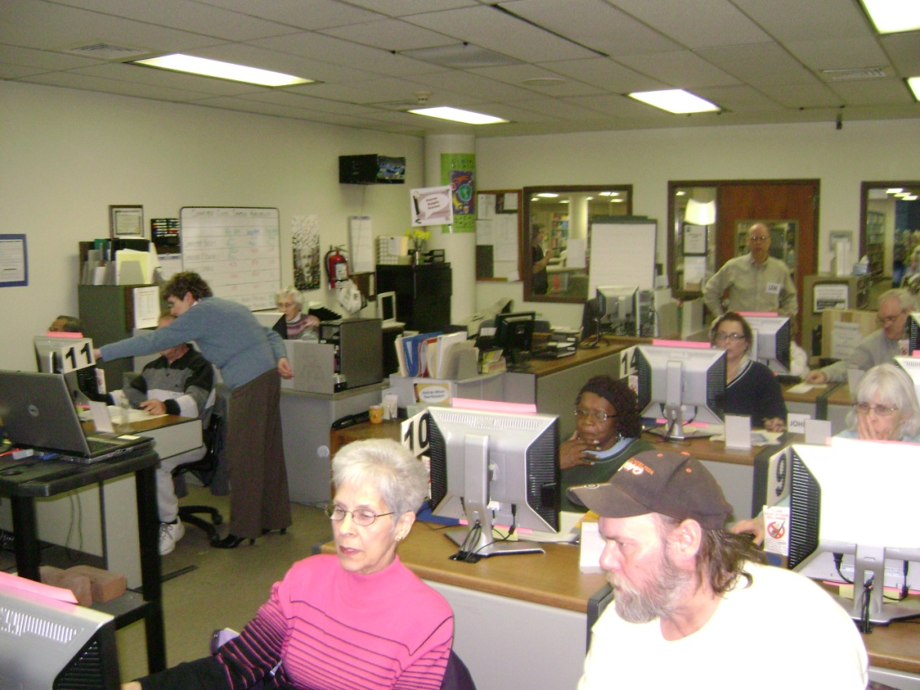

Orientation to the Computer Lab
Sixteen numbered computers for patrons
Staff Computers – Restricted Area!!
PATRONS

Slide 3
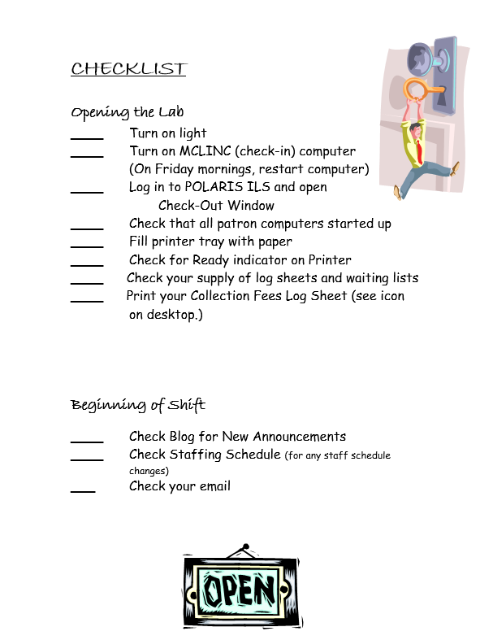
Orientation to the Computer Lab & Preparation for Service
Consult the Checklist for Opening the Lab - on bulletin board

Slide 4


Preparation for Service
Power on MCLINC computer manually – user and password in Desk Attendant Manual at check in desk.
Log in to Polaris: see Desk Attendant Manual for instructions.
Use Check-Out function to scan cards

Slide 5
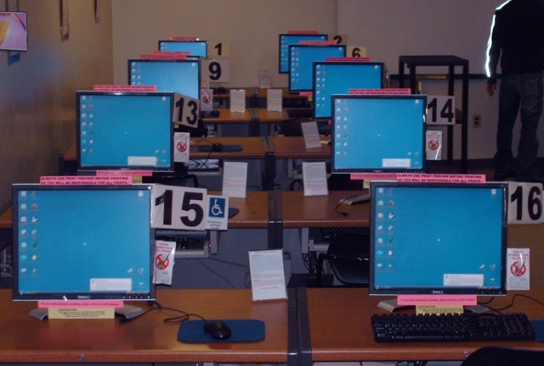
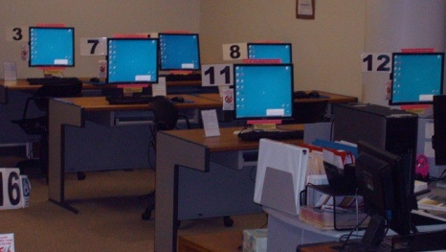
Preparation for Service
Computers boot @ 8:50 am Mon-Sat
Screensaver starts after 15 minutes
Power saver (black screen) starts 15 minutes later
Then, only way to ensure computers are on is to wiggle the mouse

Slide 6
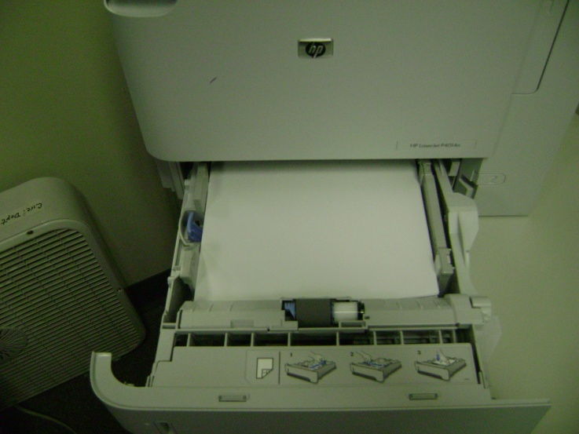
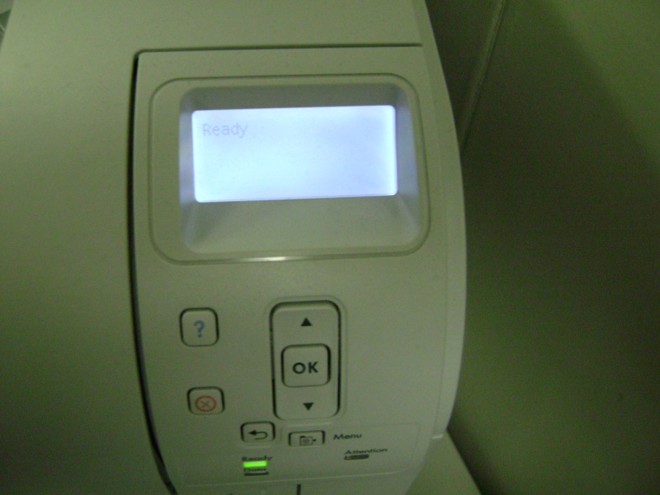
Preparation for Service

Slide 7

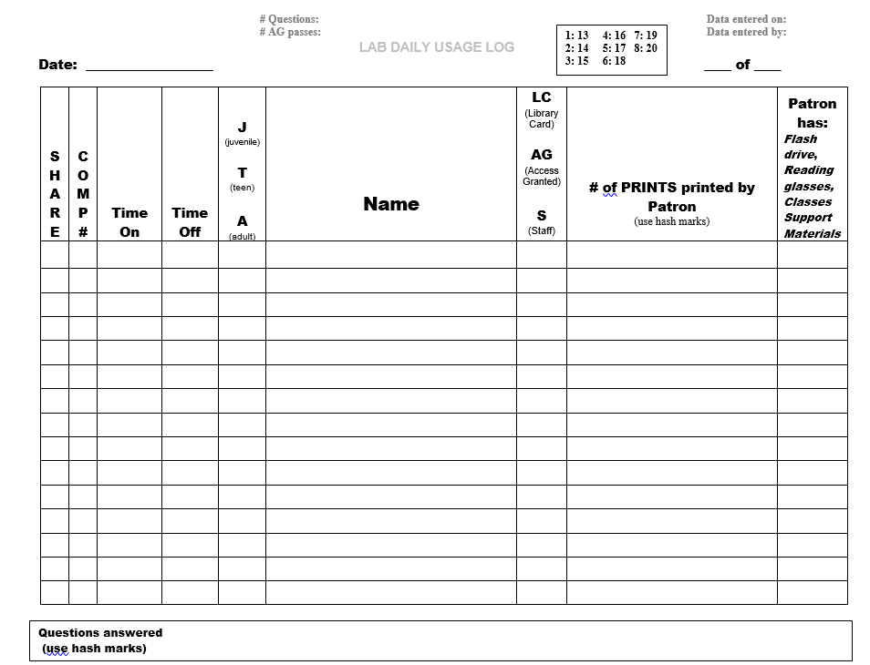
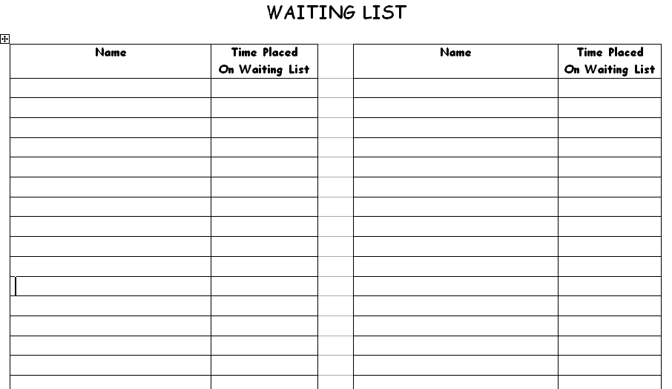
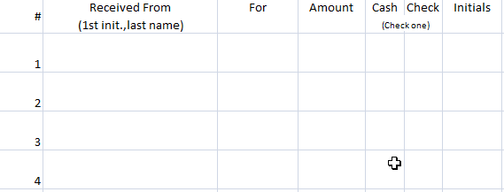
Preparation for Service

Slide 8

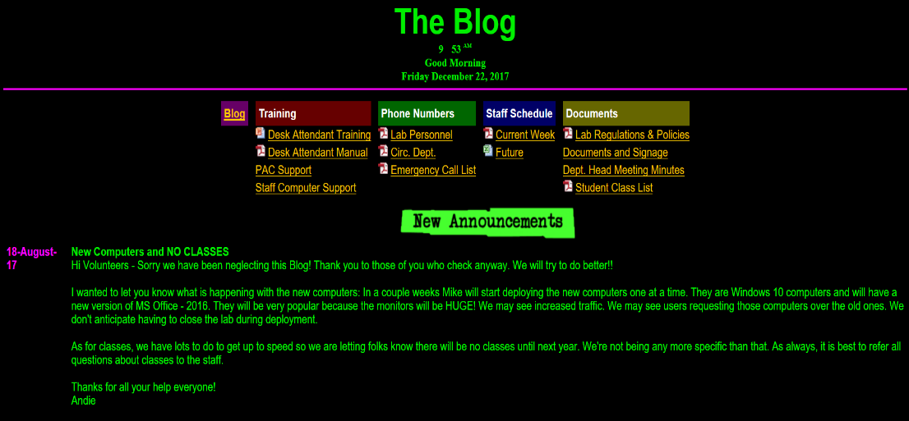
Preparation for Service

Slide 9

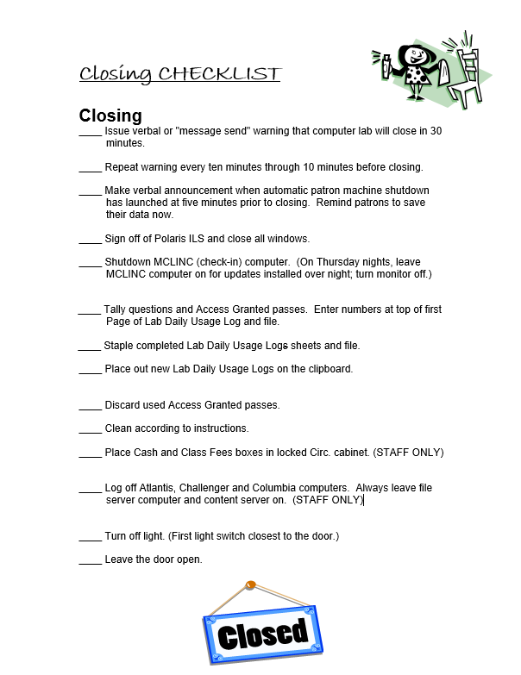

Closing the Lab – Normal Closing Time

Slide 10
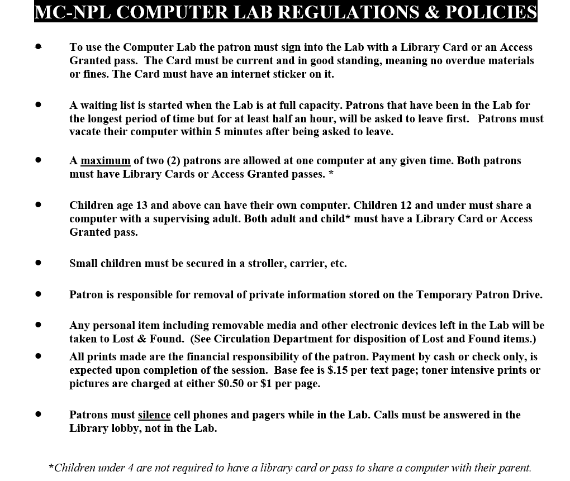
Public Access Services & Procedures

Slide 11
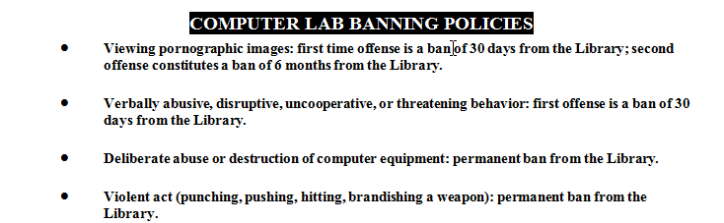
Public Access Services & Procedures

Slide 12

Lab Access Requirements
A Library Card
in Good Standing
If there is a block involving:
Expired registration
Refer to Circ Staff
Outstanding fines
Overdue materials
Cards are kept in wooden stand
Key cards must be removed from key chain

Slide 13
Lab Access Requirements
A Library Card with an MC-NPL Internet Access
Sticker
    Adult user, aged 17+
        Teen user, aged 13-16
        Juvenile user, aged 8-12, cannot have their own computer in the Lab, must always be supervised by an adult.
        Child user, under age 8, cannot have their own computer in the Lab, must always be supervised by an adult.

Slide 14
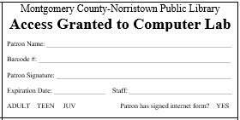
Lab Access Requirements
An Access Granted* slip from Circulation Desk or Children’s Department
The Access Granted Slip must have Adult, Teen or Juvenile circled and yes circled for Internet Access
    *The requirement for a library card or Access Granted Slip does not apply to a child under 4.

Slide 15
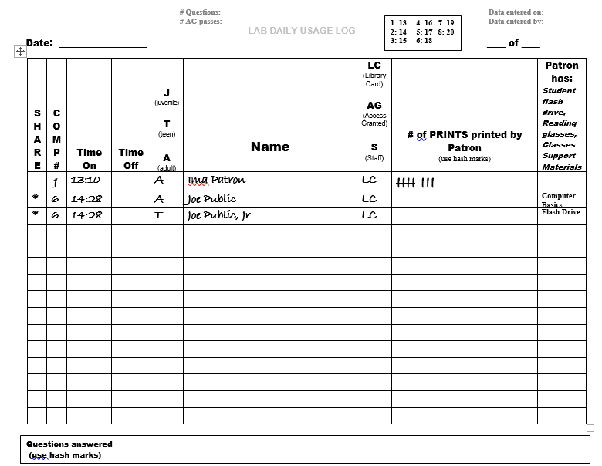
Data entry on Lab Daily Usage Log Sheets

Slide 16
Running a Waiting List
Start a waiting list when Lab is at capacity.
Patrons are guaranteed 30 minutes per visit. After that time, ask the person who has been in the Lab the longest to give up their computer.
Patrons aged 12 and under should always be referred to the Children’s Dept.
Patrons on the waiting list may not wait in the Lab.

Slide 17

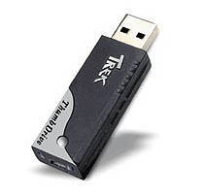
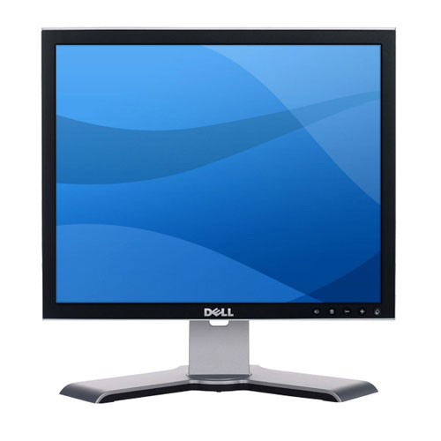
Storage Media
Patrons are allowed to bring in their own storage media and peripherals such as phones and cameras!
Files can be SAVED to these
2 USB Ports
Compact Disks
Thumb Drive

Slide 18

Storage Media
The lab no longer sells CD’s

Slide 19
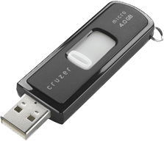
Storage Media
The lab does not loan Thumb Drives to patrons

Slide 20
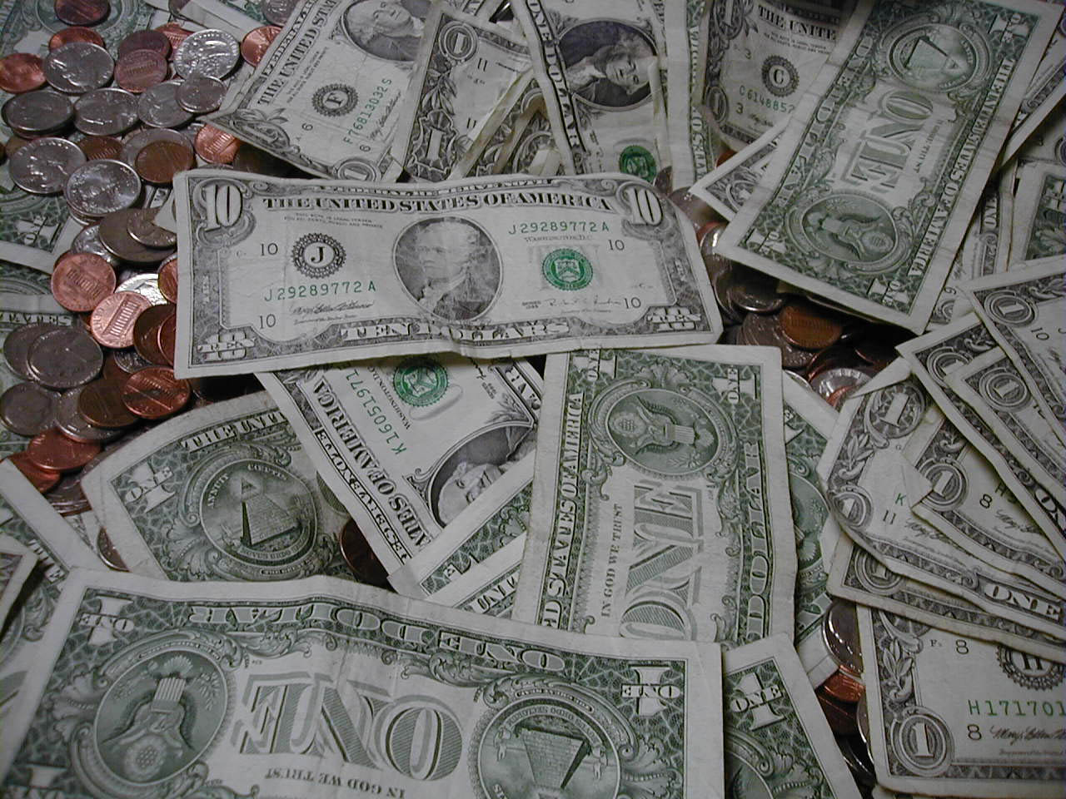

Sales and Fees
Text Printouts:
These may have thumbnail images on them (less than 1”x1”)
Text prints are charged at $.15 each.
Graphic Printouts:
up to ½ page→$.50 each page
½ page to a full page→$1.00 each page
REFUNDS

Slide 21
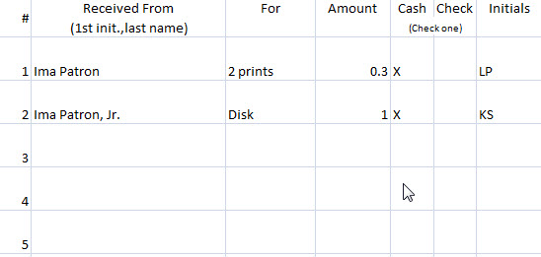
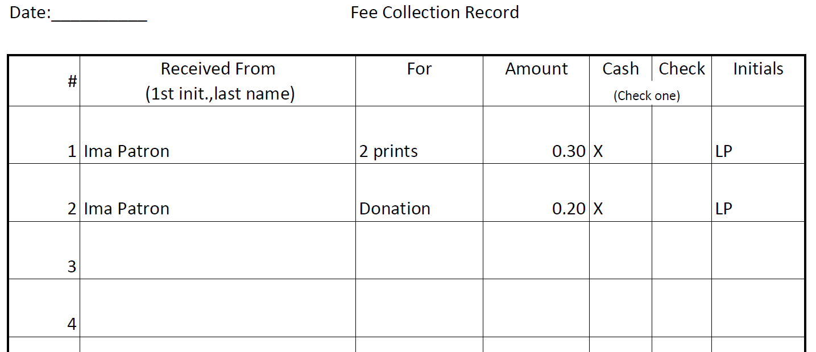
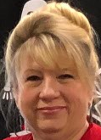
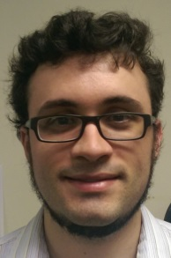

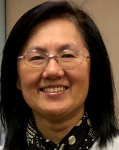
Sales and Fees
Complete a line entry in the Fee Collection Record for each payment received.
If patron wants receipt, have the payment rung up on the register at the front desk. Do not enter this type of payment on the Fee Collection Record.
Do not accept any money for Computer Classes
Refer class sign-ups to Andie, Mike, Jim, Lydia or Len (not shown)
Don’t forget to record check #

Slide 22
User Support
The following slides are meant to educate you, our Computer Lab Volunteer, on the types of questions you might be asked while you are on duty. We don’t expect our volunteers to do User Support. As a rule, there will be a lab staff member on duty at all times to whom User Support questions can be referred.

Slide 23
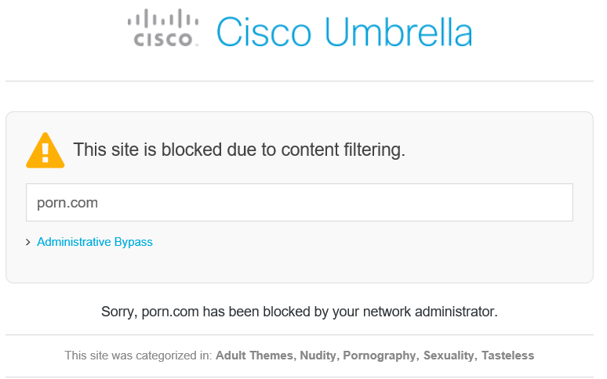
User Support
Internet FILTERING performed by Cisco Umbrella
Accessing Internet content which has been categorized by Cisco Umbrella as inappropriate will cause a window like this to pop up.
Protects minors from unwholesome webpages and our computers from website malware and viruses.
If a patron objects to the blocking of a website, make a note of the website address which is indicated in the “blocked” message.

Slide 24
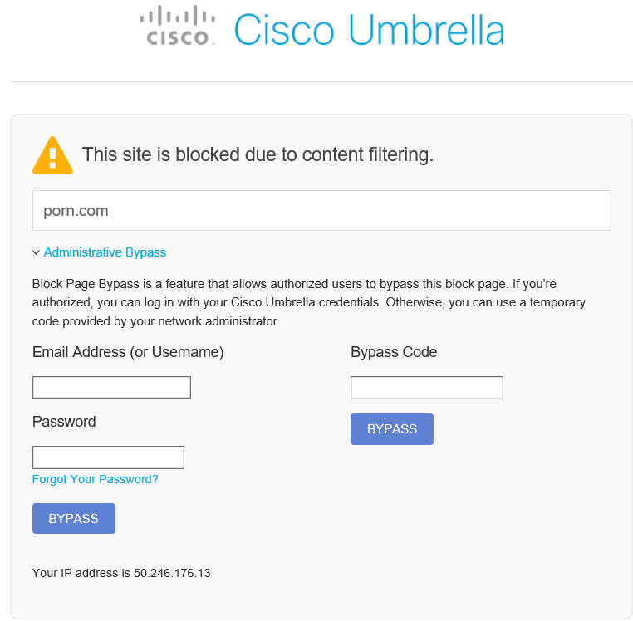
User Support
Internet FILTERING performed by Cisco Umbrella
Lab staff does not have authority to bypass the block.
Tell the patron a request will be made to the Network Administrator to unblock the website. The turnaround time for this is usually within 24 business hours.

Slide 25
User Support
PRINTING
2 steps to avoid problems:
Step
1
If a patron asks about printing, it is IMPORTANT to not only explain fees, but ask if the patron knows how to use Print Preview.
ALWAYS OFFER HELP WITH PRINTING, especially if the patron seems uncertain about using Print Preview.

Slide 26
Step
2
User Support
As soon as you hear a print job running, attend
to it. Strict diligence to this task will avoid problems.
Handling
Print Jobs
Prints from the Internet will indicate originating computer in the footer. Prints from other programs will not do this. Try to ascertain who printed what, especially if print job is large.
Patrons are not allowed to collect their own prints
Either deliver the prints to the patron or store them in the PRINT JOBS holder. Either way, mark hash marks under the appropriate computer on the Daily Log sheet.

Slide 27
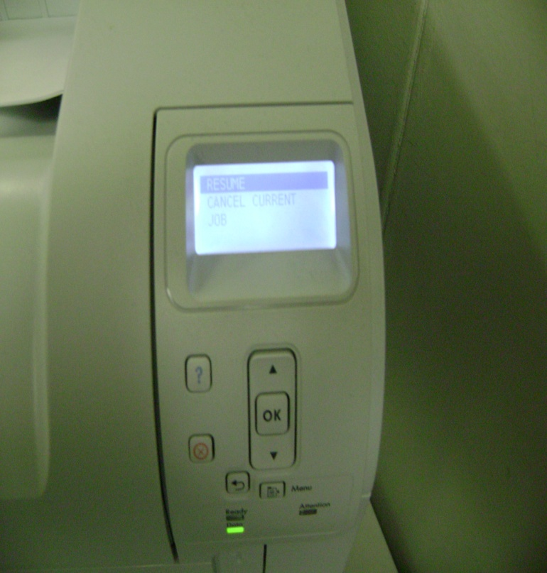
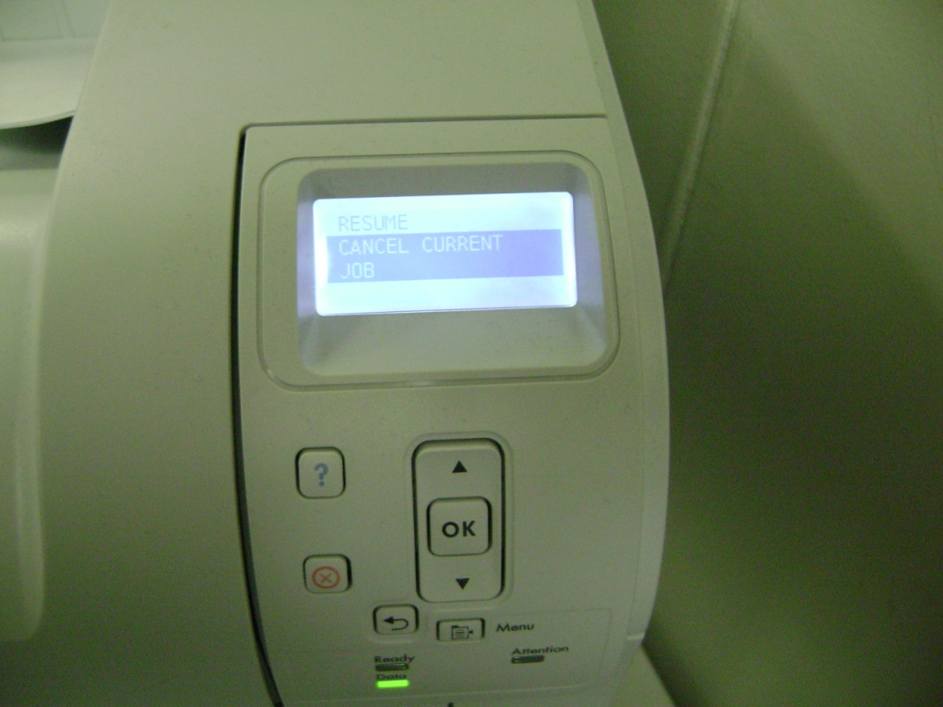
User Support
PRINTING
Printer Controls
Cancel job – Press this button on the printer if patron started a print job and didn’t realize it was as many pages as are printing out. Select “Cancel Current Job” by pressing the down arrow button. Finally, press the OK button to cancel job.

Slide 28
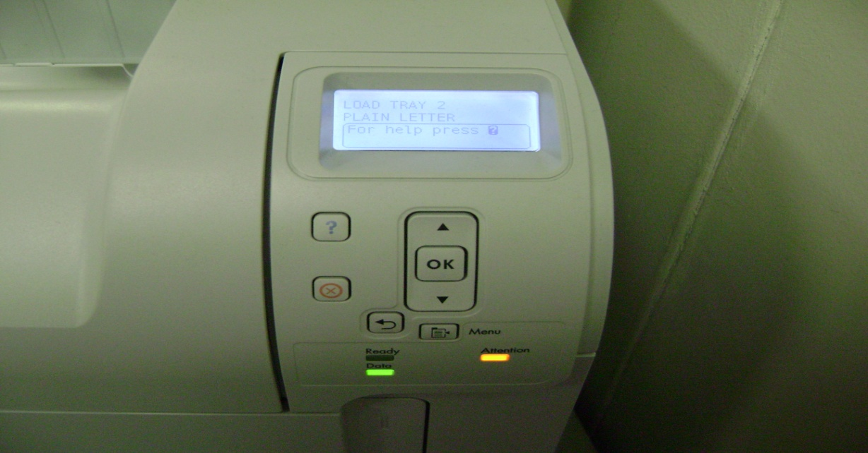
User Support
PRINTING
Printer Controls
Replacing paper: An orange light will flash when the printer needs paper. The supply is kept on shelf underneath check-in desk.
Paper tray.

Slide 29

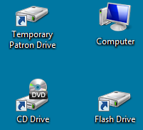
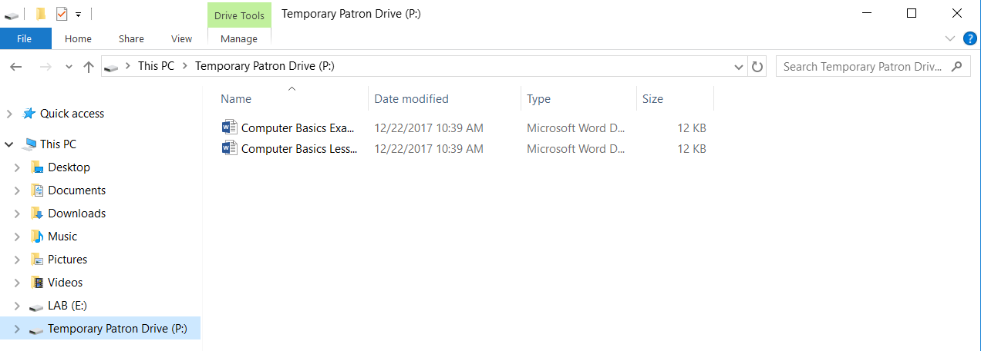
User Support
SAVING FILES
Files can be saved to CDs and thumb (USB) drives, and to the Temporary Patron Drive
If a save is to the Temporary Patron Drive, remind the patron to delete their document(s) before leaving the lab.
Unless manually deleted, files remain on the Temporary Patron Drive until the computer is restarted.

Slide 30

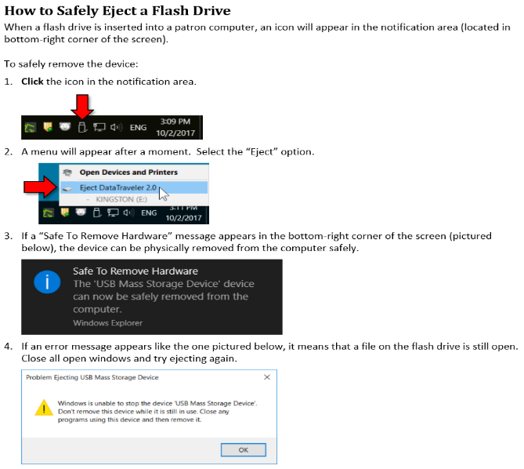
User Support
Additional Resources

Slide 31
User Support
Additional Resources

Slide 32
Thank You for Your Support!
The End

